Slide 1
W4111 – Introduction to Databases Section 003/V03, Spring 2022 Lecture 8: ER, Relational, SQL Advanced and Examples
© Donald F. Ferguson, 2022

Slide 2

Contents
2 | Introduction to Databases (F22): Lecture 8 - ER, Relational, SQL Advanced and Examples © Donald F. Ferguson, 2022

Slide 3
Contents
Some advanced ER concepts.
Worked example – modeling Columbia University and showing:
Complex ER (inheritance)
Views
Constraints
Indexes
Procedures, Functions, Triggers
And showing how to “get data from the web.”

Slide 4
ER Modeling and Implementation Reminder
4 | Introduction to Databases (F22): Lecture 8 - ER, Relational, SQL Advanced and Examples © Donald F. Ferguson, 2022

Slide 5
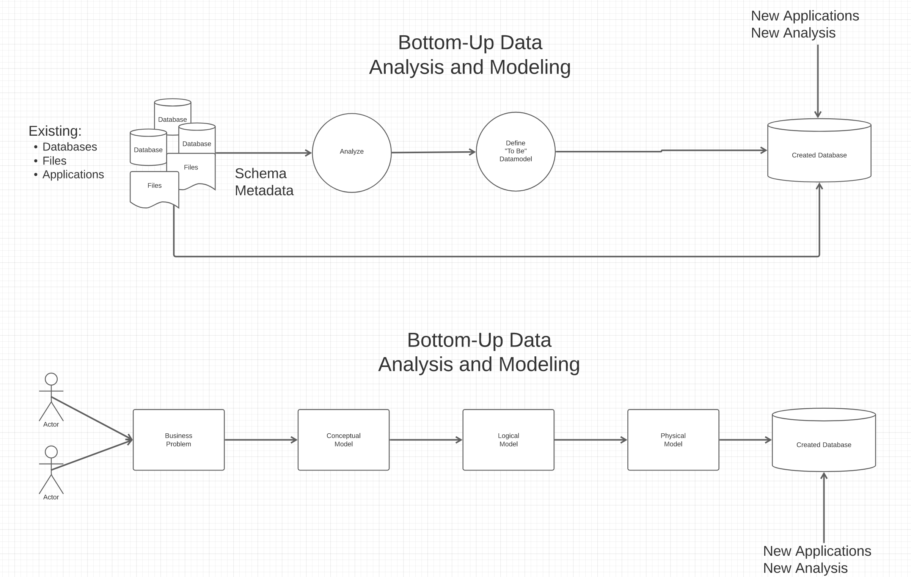
Top-Down and Bottom-Up Data Modeling
The most common is meet-in-the-middle:
Top-down defines the end state.
Bottom-up defines how to get there.
Extract-Transform-Load
Top—Down Data Modeling and Analysis

Slide 6
Bottom-Up: Game of Thrones and IMDB
Several files from IMDB:
Titles Basics
Titles AKAS
Titles Episodes
Titles Crews
Title Principals
Title Ratings
Name Basics
Tab Separated Value
To Be Data Model and DB
Game of Thrones: (https://jeffreylancaster.github.io/game-of-thrones/)
Characters, Genders, Groups
Episodes
Locations, Opening Locations
Words: Script, Bag, ... ...
Geography
... ...
JSON

Slide 7

A Common and my Approach: Conceptual → Logical → Physical
https://ehikioya.com/conceptual-logical-physical-database-modeling/
https://www.1keydata.com/datawarehousing/data-modeling-levels.html
It is easy to get carried away with modeling. You can spend all your time modeling and not actually build the schema.
We will use the approaches in class.
Mostly to understand concepts and patterns.
https://www.1keydata.com/datawarehousing/data-modeling-levels.html

Slide 8
Examples, Patterns and Anti-Patterns
In both top-down and bottom-up, you will encounter “structures” that are hard to model in ER and the relational model.
You will have to ”improvise, adapt, and overcome.”
But, you are almost certainly not the first person to encounter the challenge.
There is a body of “design patterns” for solving the challenges:
“In software engineering, a software design pattern is a general, reusable solution to a commonly occurring problem within a given context in software design. It is not a finished design that can be transformed directly into source or machine code. Rather, it is a description or template for how to solve a problem that can be used in many different situations. Design patterns are formalized best practices that the programmer can use to solve common problems when designing an application or system.”
There are also “anti-patterns:”
An anti-pattern is a common response to a recurring problem that is usually ineffective and risks being highly counterproductive.

Slide 9
Some Advanced ER Concepts
9 | Introduction to Databases (F22): Lecture 8 - ER, Relational, SQL Advanced and Examples © Donald F. Ferguson, 2022

Slide 10

Weak Entities
10 | Introduction to Databases (F22): Lecture 8 - ER, Relational, SQL Advanced and Examples © Donald F. Ferguson, 2022

Slide 11
Weak Entity Sets
Consider a section entity, which is uniquely identified by a course_id, semester, year, and sec_id.
Clearly, section entities are related to course entities. Suppose we create a relationship set sec_course between entity sets section and course.
Note that the information in sec_course is redundant, since section already has an attribute course_id, which identifies the course with which the section is related.
One option to deal with this redundancy is to get rid of the relationship sec_course; however, by doing so the relationship between section and course becomes implicit in an attribute, which is not desirable.
Covered last week. Reminder.

Slide 12
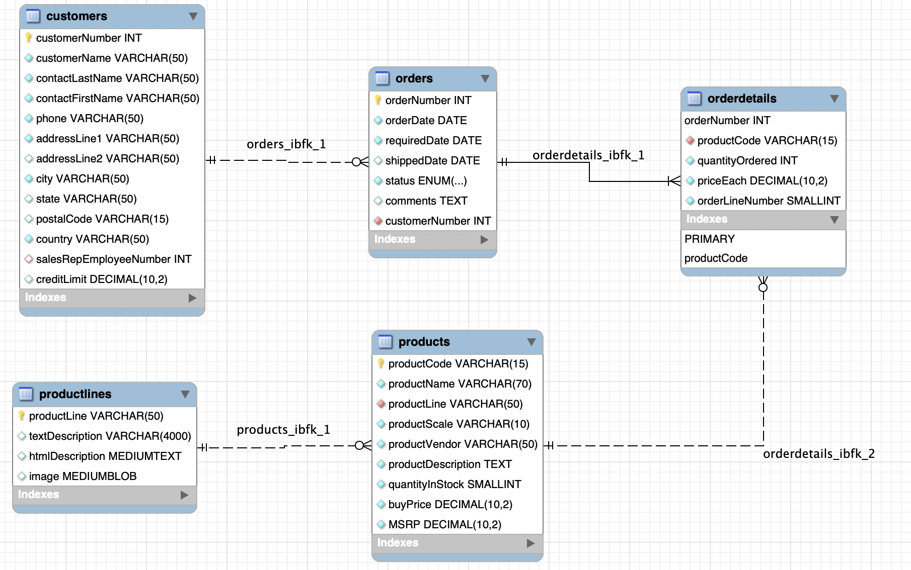
An Example – Classic Models
https://www.mysqltutorial.org/mysql-sample-database.aspx/
Weak Entity
This is one case where “on cascade” may make
sense.
Next slide.
Show to to model in Lucidchart
Demonstrate reverse engineering
12 | Introduction to Databases (F22): Lecture 8 - ER, Relational, SQL Advanced and Examples

Slide 13
Cascading Actions in Referential Integrity
When a referential-integrity constraint is violated, the normal procedure is to reject the action that caused the violation.
An alternative, in case of delete or update is to cascade
create table course ( (… dept_name varchar(20), foreign key (dept_name) references department on delete cascade on update cascade, . . .)
Instead of cascade we can use :
set null,
set default

Slide 14
Redundant, Multi-Valued
14 | Introduction to Databases (F22): Lecture 8 - ER, Relational, SQL Advanced and Examples © Donald F. Ferguson, 2022

Slide 15
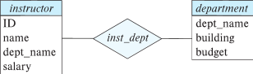
Redundant Attributes
Suppose we have entity sets:
instructor, with attributes: ID, name, dept_name, salary
department, with attributes: dept_name, building, budget
We model the fact that each instructor has an associated department using a relationship set inst_dept
The attribute dept_name in instructor replicates information present in the relationship and is therefore redundant
and needs to be removed.
BUT: when converting back to tables, in some cases the attribute gets reintroduced, as we will see later.

Slide 16
Design Alternatives
In designing a database schema, we must ensure that we avoid two major pitfalls:
Redundancy: a bad design may result in repeat information.
Redundant representation of information may lead to data inconsistency among the various copies of information
Incompleteness: a bad design may make certain aspects of the enterprise difficult or impossible to model.
Avoiding bad designs is not enough. There may be a large number of good designs from which we must choose.
Emphasis Added
Notes:
16

Slide 17
Complex Attributes
Attribute types:
Simple and composite attributes.
Single-valued and multivalued attributes
Example: multivalued attribute: phone_numbers
Derived attributes
Can be computed from other attributes
Example: age, given date_of_birth
Domain – the set of permitted values for each attribute

Slide 18
Composite Attributes
Composite attributes allow us to divided attributes into subparts (other attributes).

Slide 19
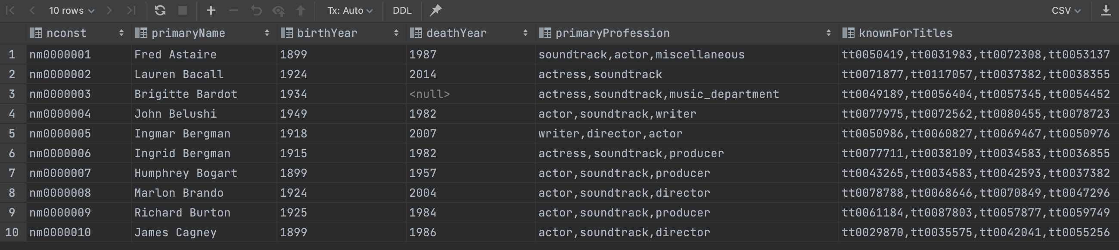
Example from IMDB
Consider name_basics
There
Is one composite attribute, primaryName.
Are two multivalued attributes: primaryProfession, knownForTitles
knownForTitles is also tricky, which we will see.
Names are also a little tricky
Switch to notebook

Slide 20
Relationships
20 | Introduction to Databases (F22): Lecture 8 - ER, Relational, SQL Advanced and Examples © Donald F. Ferguson, 2022

Slide 21
Relationship Sets (Cont.)
An attribute can also be associated with a relationship set.
For instance, the advisor relationship set between entity sets instructor and student may have the attribute date which tracks when the student started being associated with the advisor

Slide 22
Relationship Sets with Attributes

Slide 23
Roles
Entity sets of a relationship need not be distinct
Each occurrence of an entity set plays a “role” in the relationship
The labels “course_id” and “prereq_id” are called roles.

Slide 24
Degree of a Relationship Set
Binary relationship
involve two entity sets (or degree two).
most relationship sets in a database system are binary.
Relationships between more than two entity sets are rare. Most relationships are binary. (More on this later.)
Example: students work on research projects under the guidance of an instructor.
relationship proj_guide is a ternary relationship between instructor, student, and project

Slide 25
Non-binary Relationship Sets
Most relationship sets are binary
There are occasions when it is more convenient to represent relationships as non-binary.
E-R Diagram with a Ternary Relationship

Slide 26
Mapping Cardinality Constraints
Express the number of entities to which another entity can be associated via a relationship set.
Most useful in describing binary relationship sets.
For a binary relationship set the mapping cardinality must be one of the following types:
One to one
One to many
Many to one
Many to many

Slide 27
Aggregation
27 | Introduction to Databases (F22): Lecture 8 - ER, Relational, SQL Advanced and Examples © Donald F. Ferguson, 2022

Slide 28
Aggregation
Consider the ternary relationship proj_guide, which we saw earlier
Suppose we want to record evaluations of a student by a guide on a project

Slide 29
Aggregation (Cont.)
Relationship sets eval_for and proj_guide represent overlapping information
Every eval_for relationship corresponds to a proj_guide relationship
However, some proj_guide relationships may not correspond to any eval_for relationships
So we can’t discard the proj_guide relationship
Eliminate this redundancy via aggregation
Treat relationship as an abstract entity
Allows relationships between relationships
Abstraction of relationship into new entity

Slide 30
Aggregation (Cont.)
Eliminate this redundancy via aggregation without introducing redundancy, the following diagram represents:
A student is guided by a particular instructor on a particular project
A student, instructor, project combination may have an associated evaluation
Notes:
30

Slide 31
Reduction to Relational Schemas
To represent aggregation, create a schema containing
Primary key of the aggregated relationship,
The primary key of the associated entity set
Any descriptive attributes
In our example:
The schema eval_for is:
eval_for (s_ID, project_id, i_ID, evaluation_id)
The schema proj_guide is redundant.

Slide 32
Specialization
32 | Introduction to Databases (F22): Lecture 8 - ER, Relational, SQL Advanced and Examples © Donald F. Ferguson, 2022

Slide 33
Specialization
Top-down design process; we designate sub-groupings within an entity set that are distinctive from other entities in the set.
These sub-groupings become lower-level entity sets that have attributes or participate in relationships that do not apply to the higher-level entity set.
Depicted by a triangle component labeled ISA (e.g., instructor “is a” person).
Attribute inheritance – a lower-level entity set inherits all the attributes and relationship participation of the higher-level entity set to which it is linked.

Slide 34
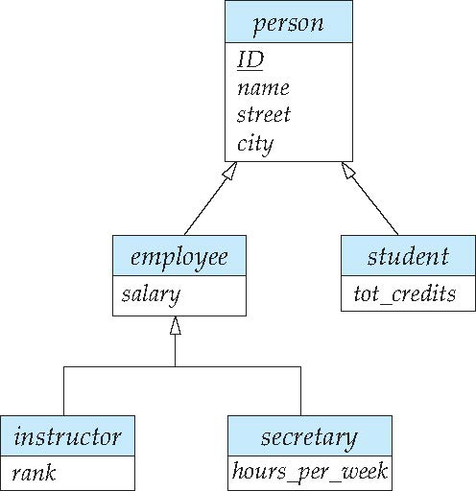
Specialization Example
Overlapping – employee and student
Disjoint – instructor and secretary
Total and partial

Slide 35
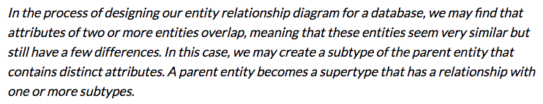
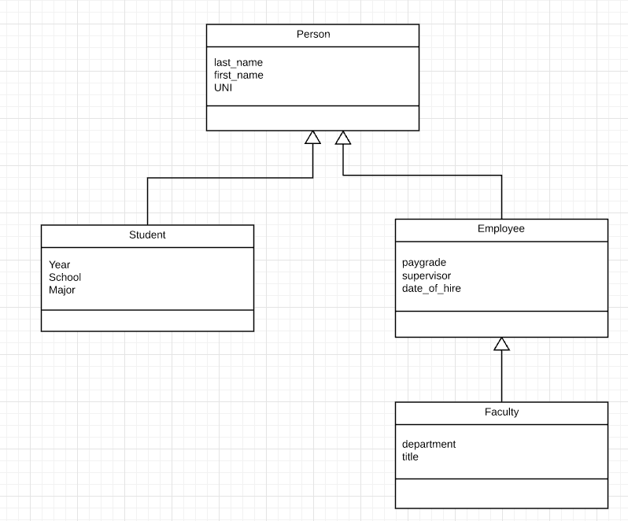
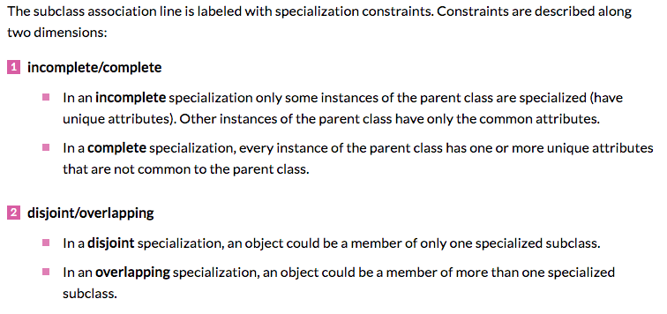
Inheritance, IsA, Specialization
Are all employees faculty?
Can students also be employees?
http://www.vertabelo.com/blog/technical-articles/inheritance-in-a-relational-database
35 | W4111_02_F20: Introduction to Databases – Lecture 6

Slide 36
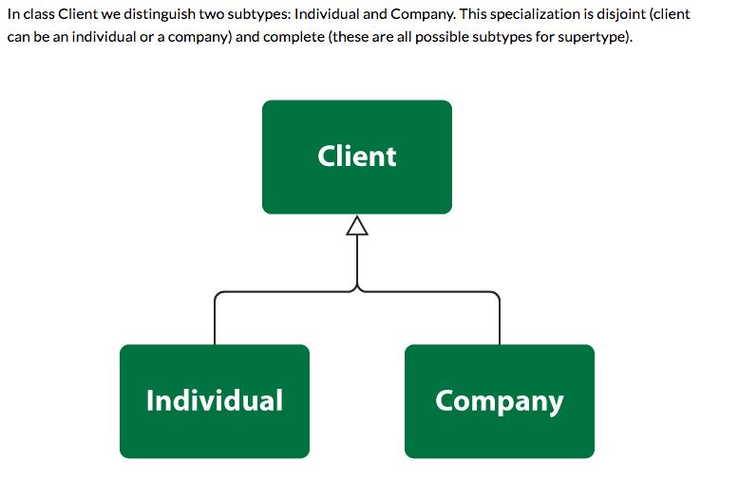
Simpler Example
36 | W4111_02_F20: Introduction to Databases – Lecture 6

Slide 37
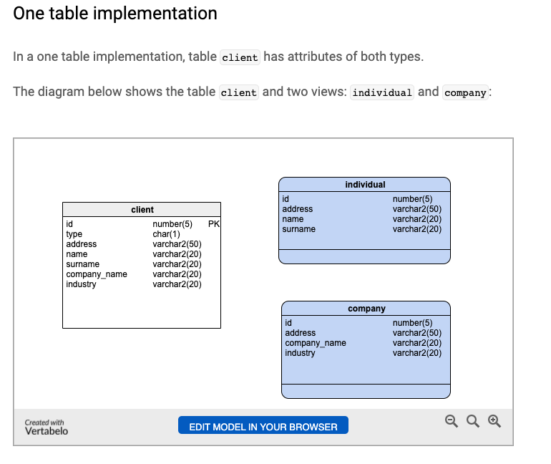
One Table Implementation
Views
Tables

Slide 38
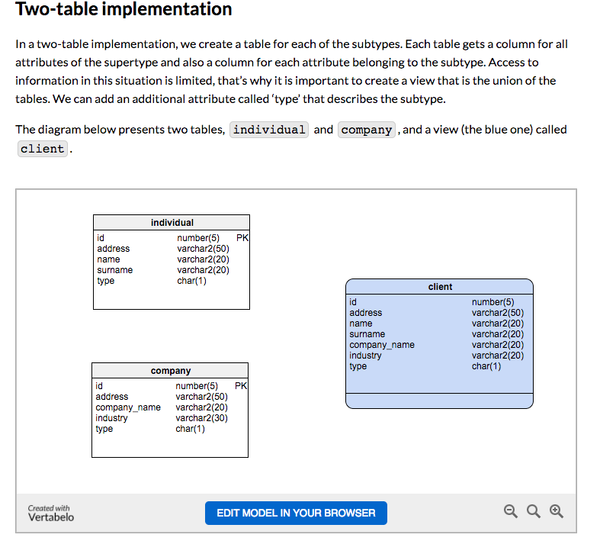
Two Table Implementation
View
Tables
38 | W4111_02_F20: Introduction to Databases – Lecture 6

Slide 39
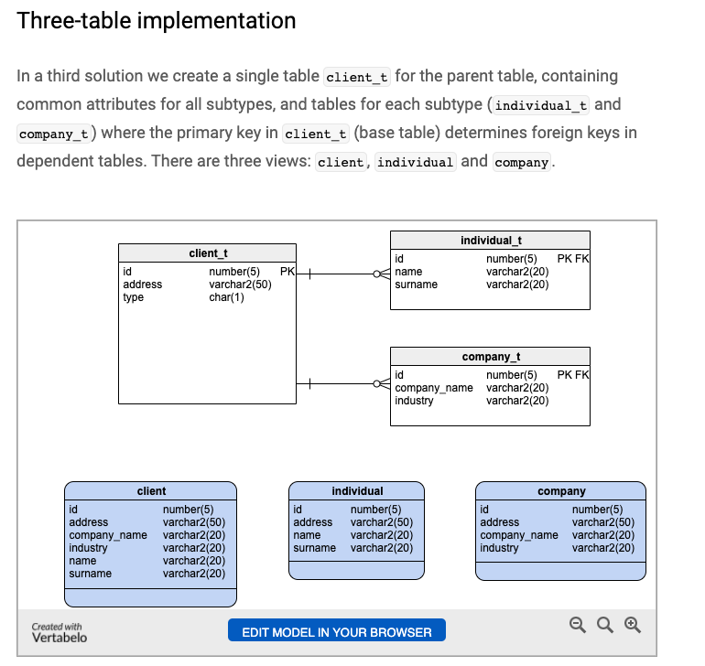
Two Table Implementation
Tables
Views
39 | W4111_02_F20: Introduction to Databases – Lecture 6

Slide 40
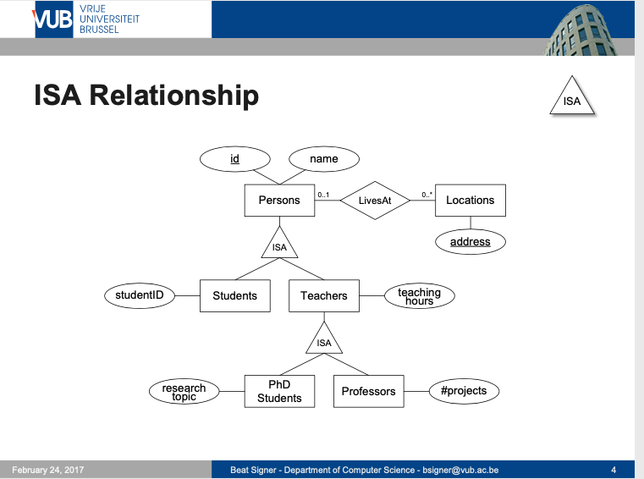
Modeling
40 | W4111_02_F20: Introduction to Databases – Lecture 6

Slide 41
ER vs. UML Class Diagrams
ER Diagram Notation
Equivalent in UML
I use this approach in Crow’s Foot Notation but that is not standard.
* Generalization can use merged or separate arrows independent
of disjoint/overlapping

Slide 42
Faculty, Student Inheritance Example
42 | Introduction to Databases (F22): Lecture 8 - ER, Relational, SQL Advanced and Examples © Donald F. Ferguson, 2022

Slide 43
Topics
Departments table – show how I got the data.
Generating test data.
Two table pattern for inheritance. Descriminator in the view.
ER diagram convention.
DDL
Generate UNI with a function.
Make the UNI immutable with a trigger.
Check constraint on enrollment versus graduation date.
Procedure for creating/updating/etc a person.
Hiding sensitive information.
Keys and indexes: UNI, email, names, department

